Slide 1
Compare predictive models created in different languages with DALEX and friends
Szymon Maksymiuk
Why R? 2019, Warsaw, 30 September 2019
Notes:
Przedstawić się
Powiedzieć coś w styl „today I’d like to talk about comparison of predictive models”

Slide 2


About me
Bachelor candidate in Data Science
Interested in:
XAI
R and Python integration
So far ripleyed once
Notes:
O mnie coś powiedzieć
Reprezentuję uczelnię oraz MILAB
Interesuję się XAI oraz integracją
So far ripleyed once but I try not to discorauge since it it’s a ticket to exclusive #teamripleyed

Slide 3
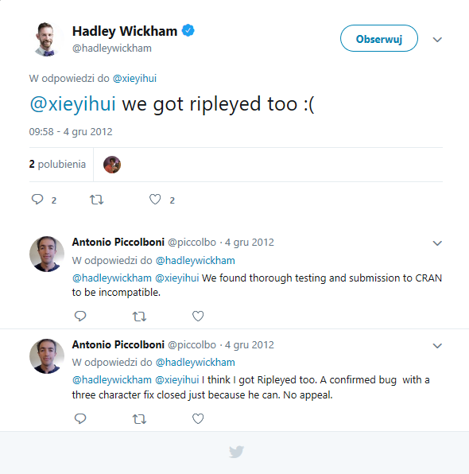

Slide 4
Agenda
Explaining Python models in R
DALEX
reticulate
explain_scikitlearn
Comparison of models
Common methods
Funnel plot
Performance audit
Overall comparison
Create your report!

Slide 5
What actually XAI is?

Slide 6
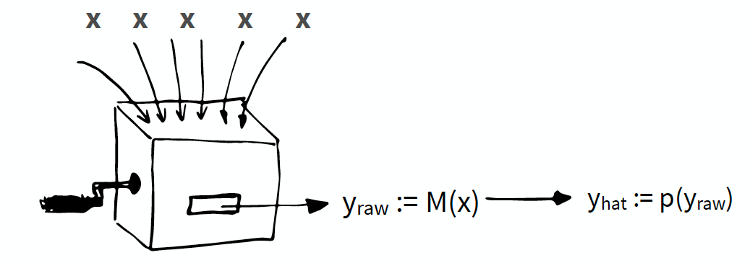
XAI
Models are more and more sophisticated. They can have thousands of coefficients.
In many applications we need to inspect how model treats our input.
We need tools to estimate model parameters.

Slide 7
Why do we need to integrate?
Notes:
Ok but all jokes aside, at least for a while…
It may seems philosophical, but it is a really simple question
Many different methods in Pyhton, like LIME, anchors
Even twice as more in R, mainly DALEX
We want to compare them in a unified way
Using same tools even if models were fit and created in a different languges

Slide 8
To establish common ground between two, significantly different, environments
Compare models in a unified way
Use same tools for every model
Make benchmarks that will not be affected by runtime environment

Slide 9

DALEX - Descriptive mAchine Learning EXplanations
Wrapper over a model. Core of DrWhy.ai universe.
Helps to understand how complex models are working.
Can work with any type of black-box models.
Notes:
Speaking of R tools explanations. Lets talk a bit about DALEX
DrWhy universe – iBreakDown, Ingredients, ModelStudio, auditor etc
Variable importance – shows impact of variables on the model
Variable response – Shows impact of one variable

Slide 10
How to integrate?

Slide 11


Reticulate
Lets us evoke Python commands from R code.
Allows to use Python object as R one.
Trivia – will not work if user name has non-ASCII signs

Slide 12
Explain!

Slide 13
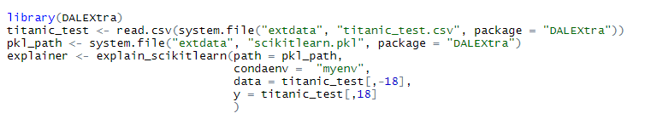
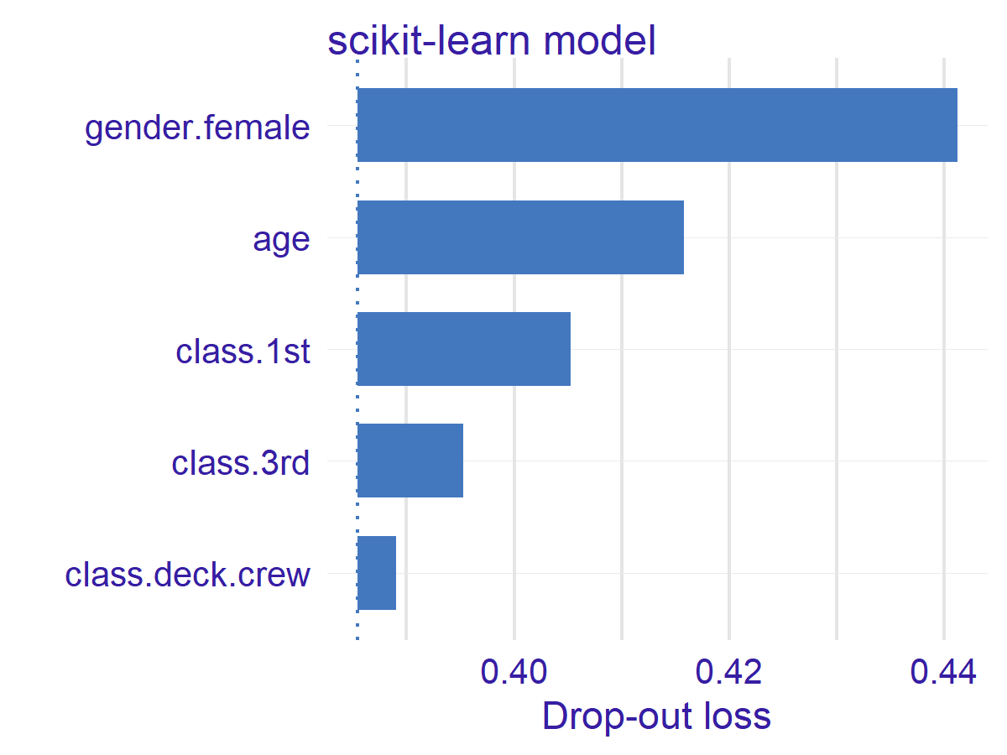
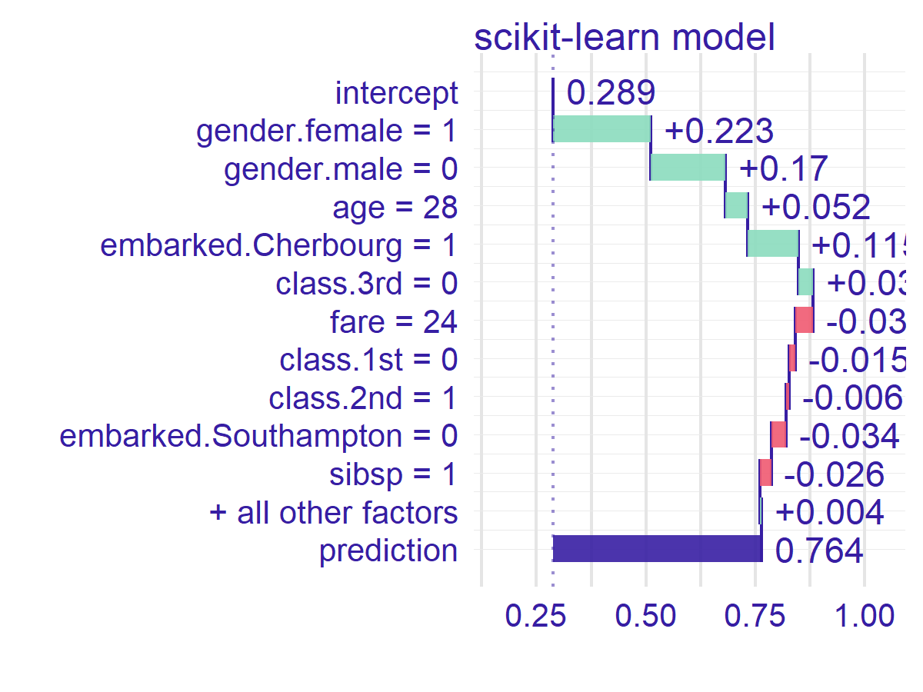
explain_scikitlearn function
ingredients
iBreakDown

Slide 14
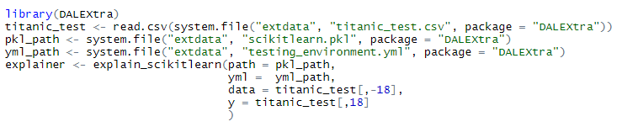
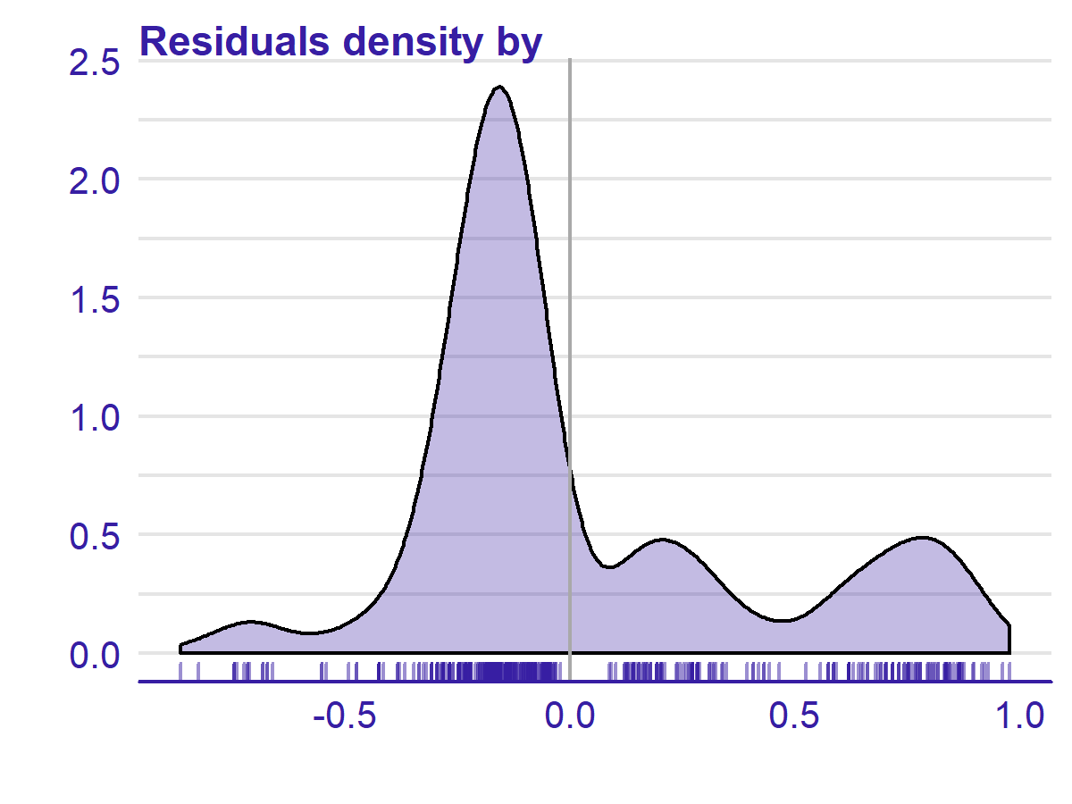
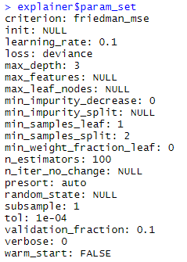
explain_scikitlearn function
auditor package

Slide 15
How can we use integration?

Slide 16
How can we compare models?

Slide 17
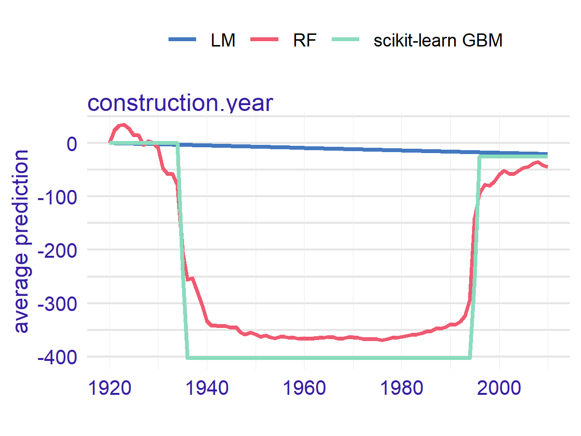
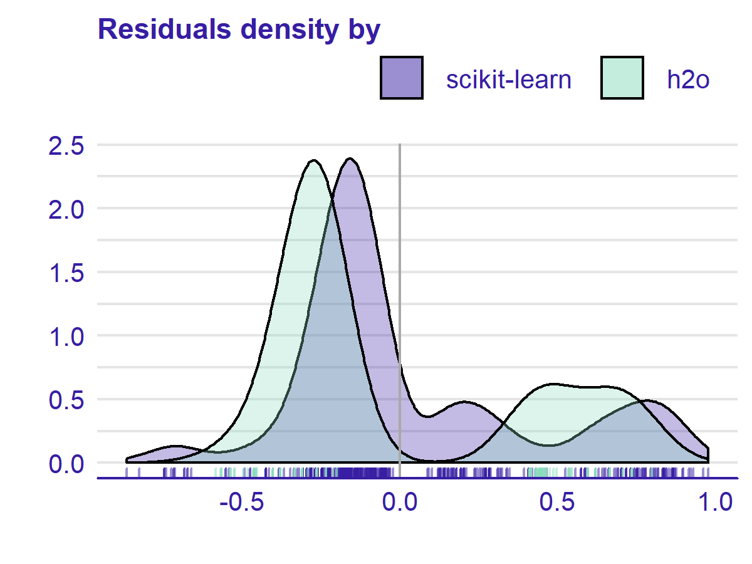
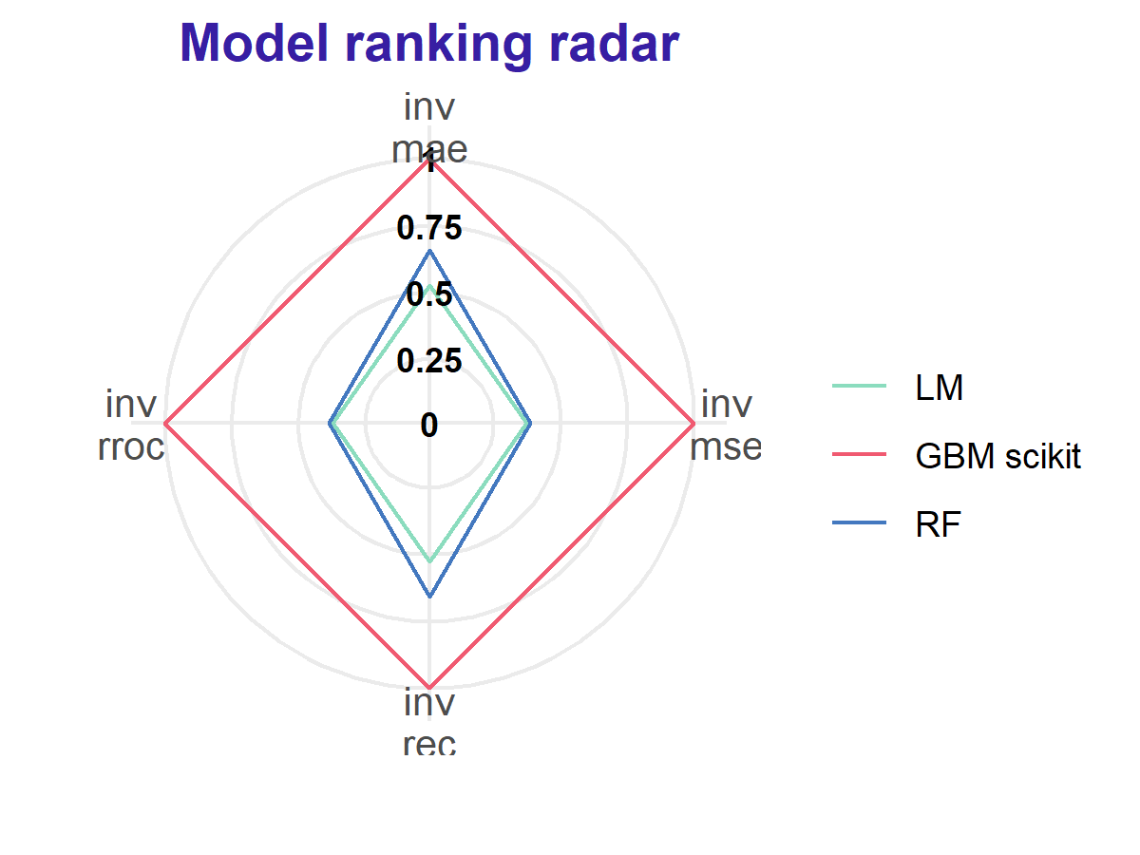
Examples of methods for model comparison
Residual audit
auditor package
Explanation comparison
Variable importance, variable response
Performance
Comparison of measures across whole test set or its subsets

Slide 18
Funnel plot

Slide 19
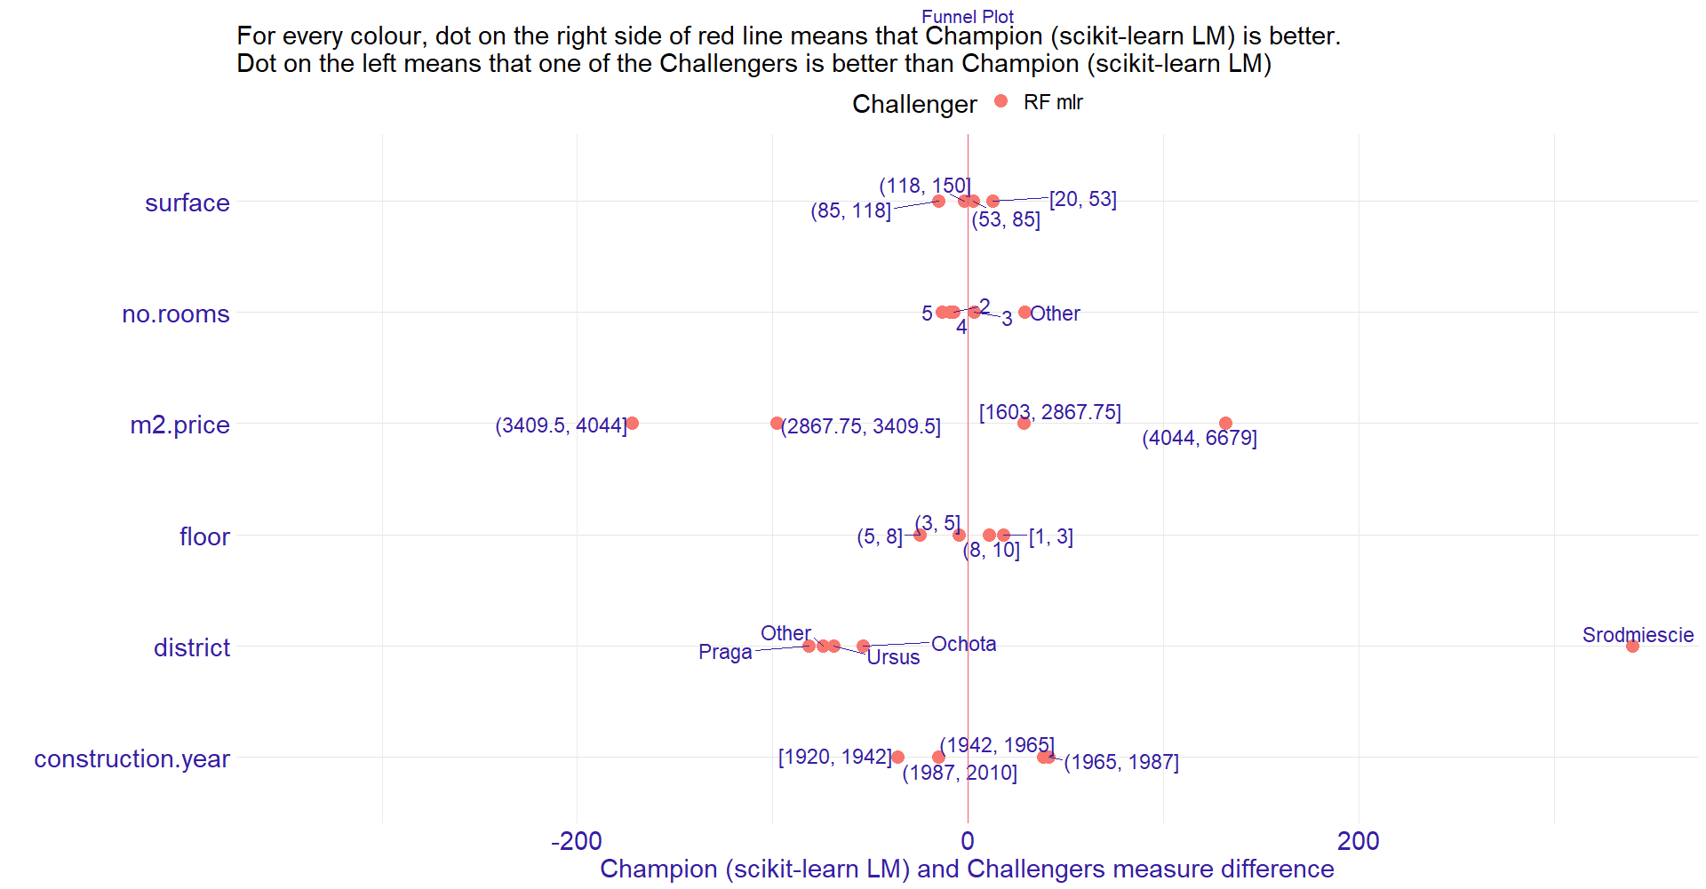

Slide 20
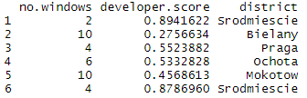

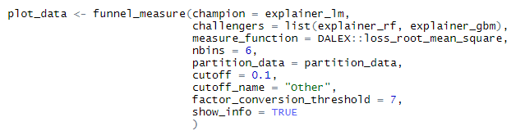
How to use it?
Most simple scenerio
Pro scenerio

Slide 21


Slide 22
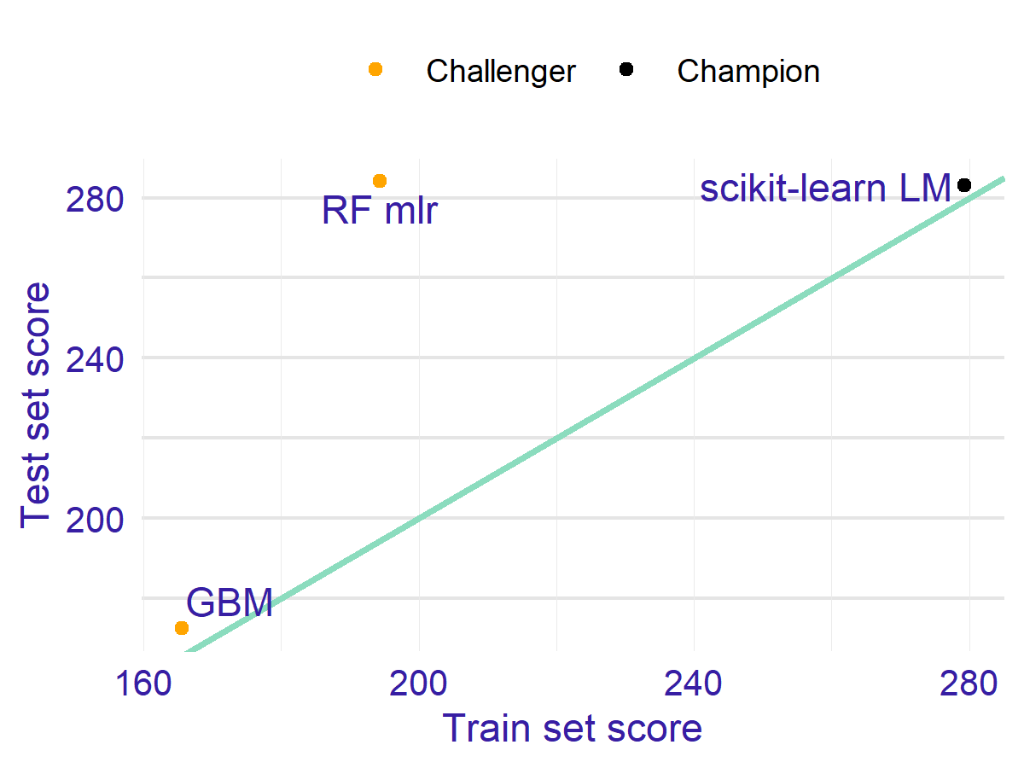
Performance audit

Slide 23
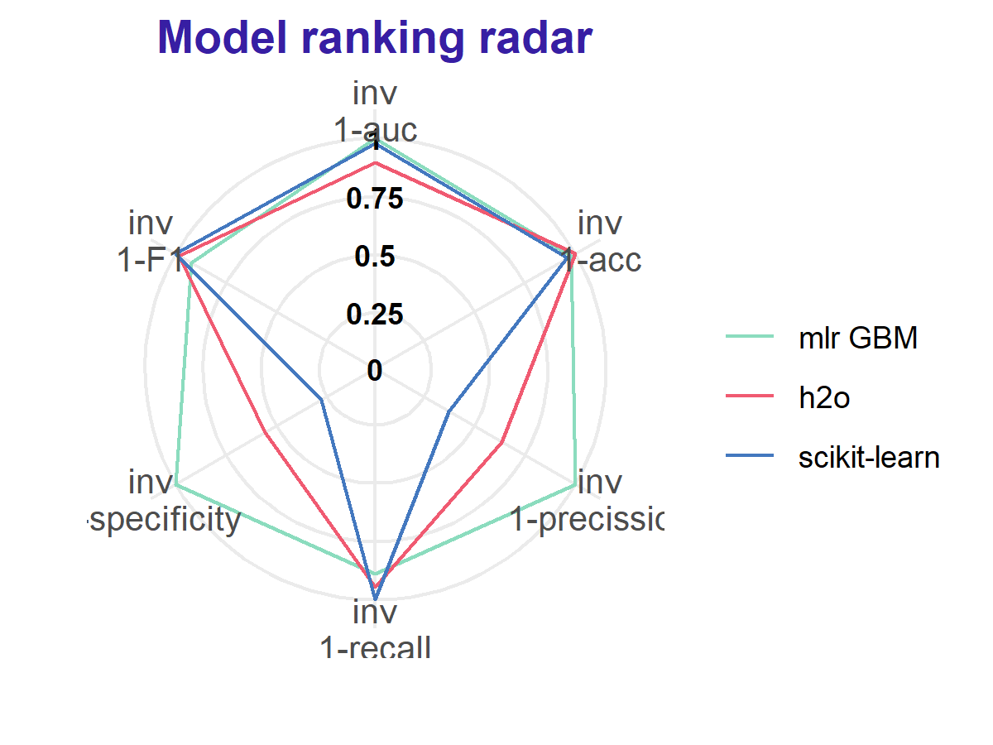
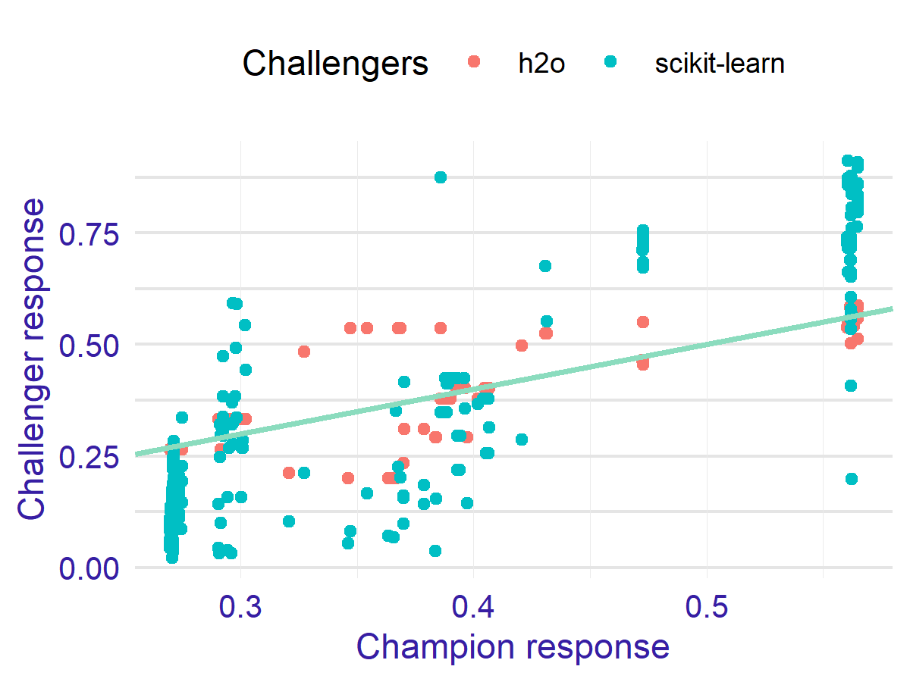
Overall comparison

Slide 24
Create report!
Creates a report out of explanations.
Every explanation with generic plot function can be included in the report as separate section
Sections provided with DALEXtra have additional description in the output.
Here should be a screen of the report but I’ve decided to show whole instead! ☺

Slide 25


Slide 26
Acknowledgments
dr hab. Przemysław Biecek, prof. PW
dr Michał Burdukiewicz
Alicja Gosiewska
Mateusz Staniak
Whole MI2DataLab team
Work on this package was financially supported by the ‘NCN Opus grant 2016/21/B/ST6/02176’.

Slide 27
https://CRAN.R-project.org/package=auditor
https://CRAN.R-project.org/package=DALEX
https://CRAN.R-project.org/package=iBreakDown
https://CRAN.R-project.org/package=ingredients

